Slide 1


0
10
9
8
7
6
5
4
3
2
1

Slide 2

Robotics Corner

Slide 3
Navigation Stack

Slide 4
01
What is Navigation Stack
02
Navigation Concepts
AGENDA
03
Taxonomy of Navigation
Localization Planning
04
Building a Map

Slide 5


Navigation using ROS
Introduction to Navigation stack
01285960031
01285960031
www.roboticscorner.tech

Slide 6
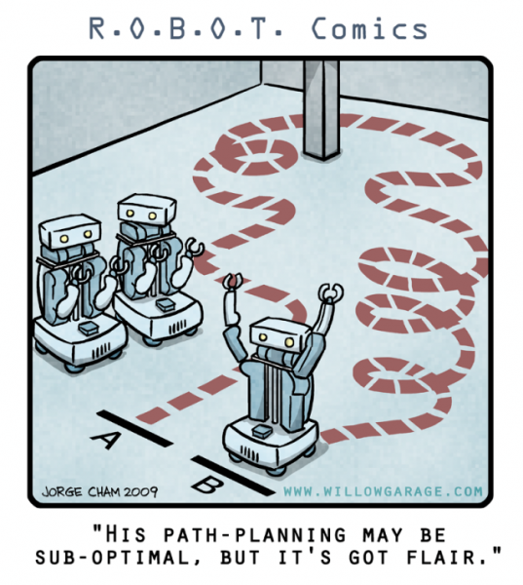
01
What is Navigation Stack
Definition
The Navigation Stack is fairly simple on a conceptual level. It takes in information from odometry and sensor streams and outputs velocity commands to send to a mobile base.
Navigation Concepts:
Map, Robot Pose, and Path
Building a Map
Localization
Planning
01285960031
01285960031
www.roboticscorner.tech

Slide 7
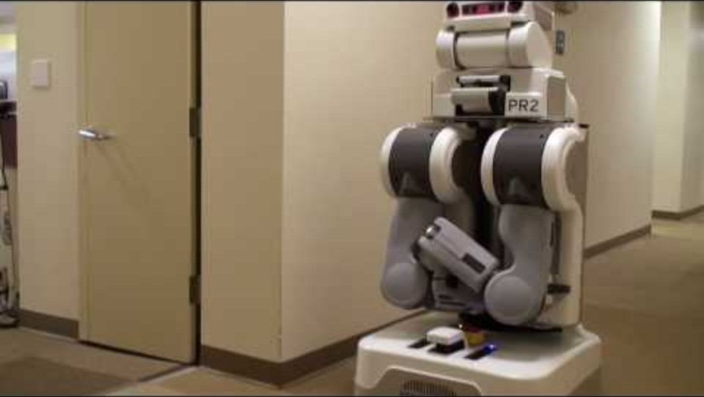

Slide 8
01
What is Navigation Stack
Navigation Stack Requirements?
While the Navigation Stack is designed to be as general purpose as possible, there are three main hardware requirements that restrict its use:
It is meant for both differential drive and holonomic wheeled robots only. It assumes that the mobile base is controlled by sending desired velocity commands to achieve in the form of: x velocity, y velocity, theta velocity.
It requires a planar laser mounted somewhere on the mobile base. This laser is used for map building and localization.
The Navigation Stack was developed on a square robot, so its performance will be best on robots that are nearly square or circular. It does work on robots of arbitrary shapes and sizes, but it may have difficulty with large rectangular robots in narrow spaces like doorways.
01285960031
01285960031
www.roboticscorner.tech

Slide 9
To navigate
01
What is and why Linux
A metric map defines a reference frame.
To operate in a map, a robot should know its position in that reference frame.
A sequence of waypoints or of actions to reach a goal location in the map is a path.
01285960031
01285960031
www.roboticscorner.tech

Slide 10
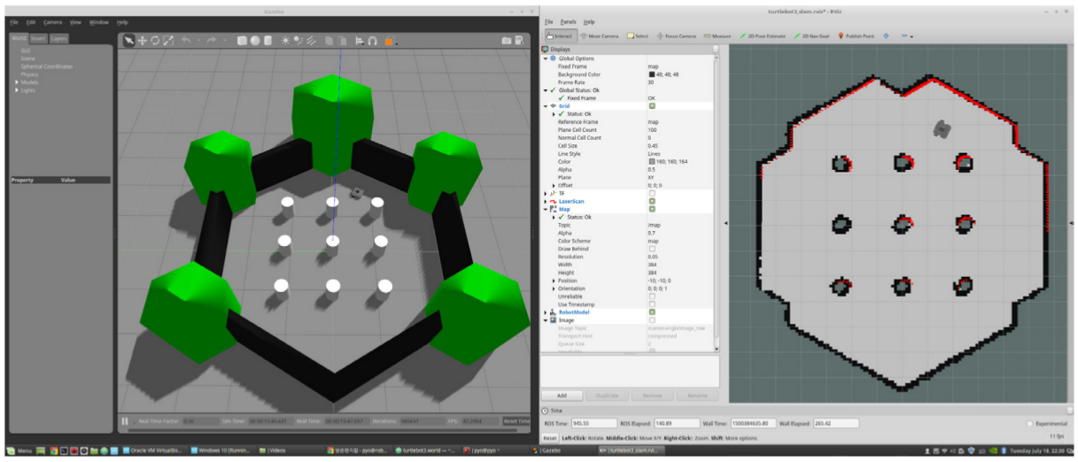
01
What is Navigation Stack
Sense - Plan - Act
To accomplish a task, a robot should “understand” the environment from its sensor measurements.
Understanding: capturing the information at the right level of abstraction.
An autonomously navigating robot should know
what the environment looks like
where it is in the environment
…
01285960031
01285960031
www.roboticscorner.tech

Slide 11
01
What is and why Linux
Navigation
Mapping
Localization
Path Planning
01285960031
01285960031
www.roboticscorner.tech

Slide 12
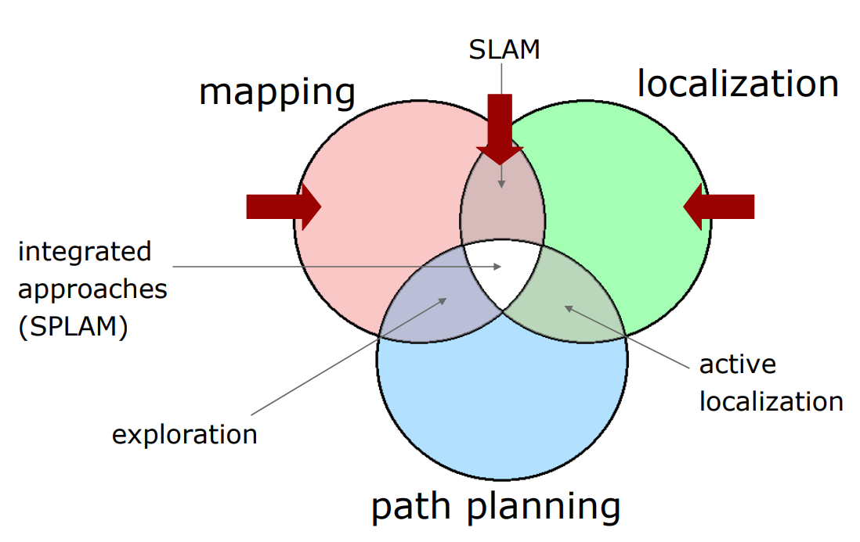
01
What is and why Linux
Mapping
Localization
Path Planning
01285960031
01285960031
www.roboticscorner.tech

Slide 13
01
What is and why Linux
01285960031
01285960031
www.roboticscorner.tech

Slide 14
Mapping
01
What is and why Linux
Given a robot that has a perfect ego- estimate of the position, and a sequence of measurements, determine the map of the environment.
A perfect estimate of the robot pose is usually not available.
Instead we solve a more complex problem: Simultaneous Localization and Mapping (SLAM).
01285960031
01285960031
www.roboticscorner.tech

Slide 15
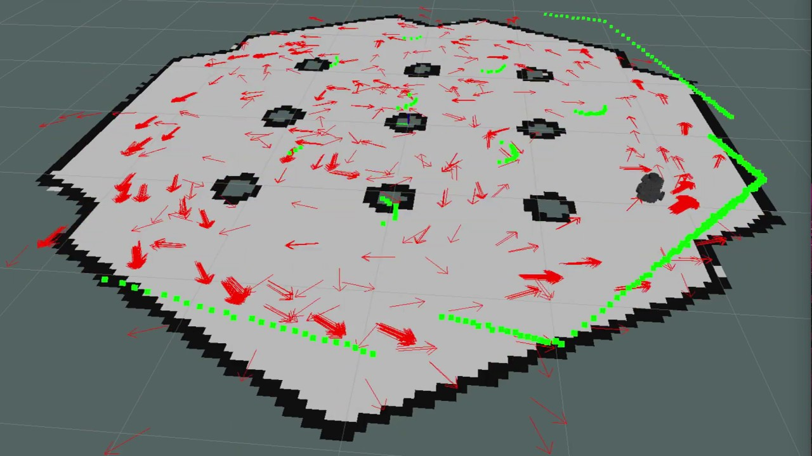
Localization
01
What is and why Linux
Determine the current robot position, the measurements up to the current instant and a map.
01285960031
01285960031
www.roboticscorner.tech

Slide 16
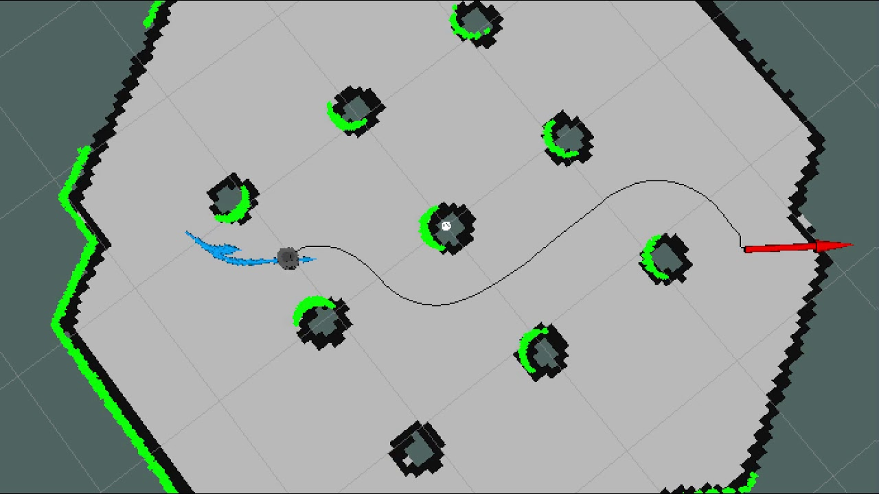
Path planning
01
What is and why Linux
Determine (if it exists) a path to reach a given goal location given a localized robot and a map of traversable regions
01285960031
01285960031
www.roboticscorner.tech

Slide 17
To navigate a robot, we need:
01
What is and why Linux
A map
A localization module
A path planning module
These components are sufficient if
The map fully reflects the environment
The environment is static
There are no errors in the estimate
However, if
The environment changes (e.g. opening/closing doors )
It is dynamic (things might appear/disappear from the perception range of the robot)
The estimate is “noisy”
Then, we need to complement our ideal design with other components that address these issues, namely
Obstacle-Detection/Avoidance
Local Map Refinement, based on the most recent sensor reading.
01285960031
01285960031
www.roboticscorner.tech

Slide 18
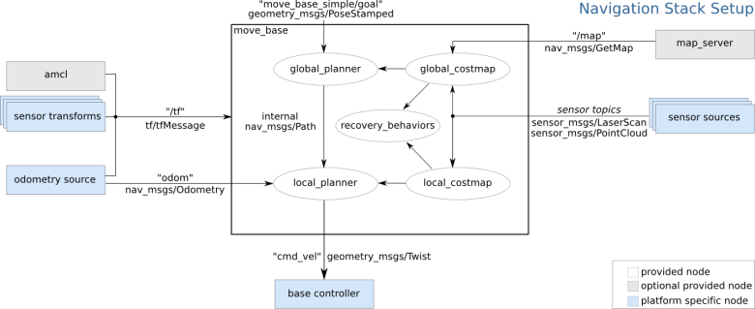
Navigation stack
01
What is and why Linux
Map provided by a “Map Server”
Each module is a node
Planner has a layered architecture (local and global planner)
Obstacle sensing refined on-line by appropriate modules (local and global costmap)
http://wiki.ros.org/navigation
01285960031
01285960031
www.roboticscorner.tech

Slide 19
01
What is and why Linux
01285960031
01285960031
www.roboticscorner.tech

Slide 20
How to use navigation stack
01
What is and why Linux
Install navigation stack using this line
sudo apt-get install ros-noetic-navigation
To see if it installed correctly, type:
rospack find amcl
01285960031
01285960031
www.roboticscorner.tech

Slide 21
References
01
What is and why Linux
https://automaticaddison.com/how-to-set-up-the-ros-navigation-stack-on-a-robot/
01285960031
01285960031
www.roboticscorner.tech

Slide 22



Slide 23

01211626904
www.roboticscorner.tech
Robotics Corner
Robotics Corner
Robotics Corner
Robotics Corner

